Slide 1

“Location analysis of sales agents in national territory”
Data Analytics Boot Camp Project #1
February 2021

Slide 2
Team 5
Joyce Casiano
Elena Sánchez
Ignacio Morales
Oscar Morales
Eduardo Chacón
Carlos Valverde

Slide 3
Agenda
Background
Analysis Objetive
Data Sources
Processing
Results
Conclusions
Learned Lessons
Challenges

Slide 4
Background
The dental sector in Mexico, which generates around four billion dollars a year, it will grow faster than the national average in 2020. According to AMIC
However, the reality in 2020 was different, mainly due to the global pandemic unleashed in the first quarter of that year.
Faced with such situation, companies dedicated to distributing dental materials such as consumables in dental clinics and offices, they have been looking for new ways to optimize their sales resources. For this reason, a company with a national presence has asked the team of analysts to prepare a study that includes an analysis of its sales force.

Slide 5
Analysis Objetive
The company has made decisions to adjust its organizational structure in order to generate savings, however, it is concerned to know if the decisions made will greatly affect its operations once the emergency of the pandemics ends, for this reason, they have raised various questions to be answered and which are the starting point of the study and analysis.
Where would be the optimal place to locate sales representatives in the national territory?
Where
The company has requested that a study and analysis be carried out based on data and verifiable facts, they have requested that a study be presented to them with conclusions explaining the methodology used to reach them.

Slide 6
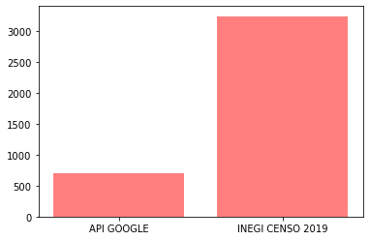
Data Sources
To obtain data on dental offices throughout the national territory, two data sources were explored, the Google Places site and the INEGI site.
After analyzing the two sources, the decision was made to continue the analysis with the INEGI data because it is more complete, proof of this is the number of economic entities (dental offices) found with each sources and which is shown in the following graph.
Número de consultorios dentales
Número
INEGI data was also considered for other indicators such as socioeconomic level population

Slide 7
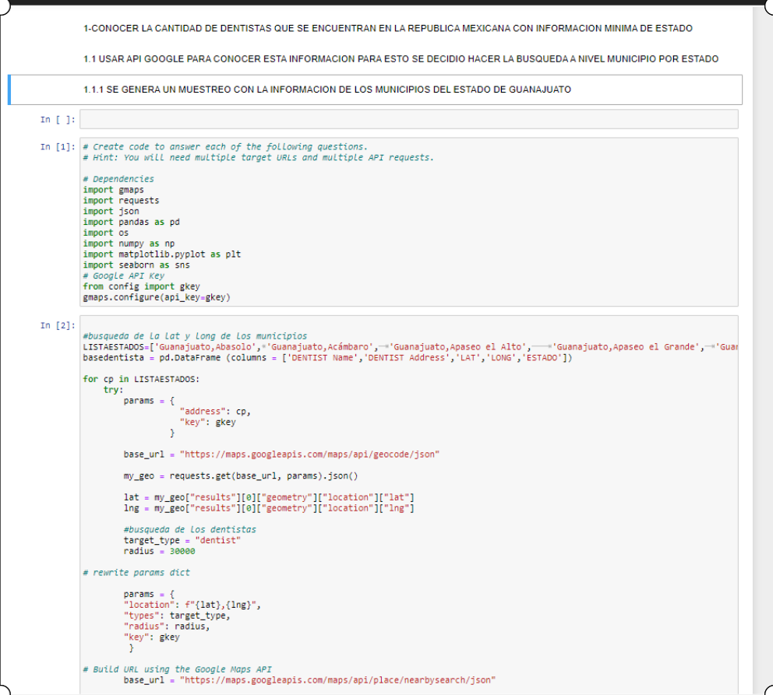
Processing
The process the data used, a series of codes was developed with which it was possible, among other things, to obtain the data directly from its sources, review the quality of the data and clean it when necessary, process it and generate graphics that help to reach and to support the conclusions that were reached.
They were used among others:
Google API’s
Google Maps
Jupyter Notebook
Git Hub
Python Pandas

Slide 8
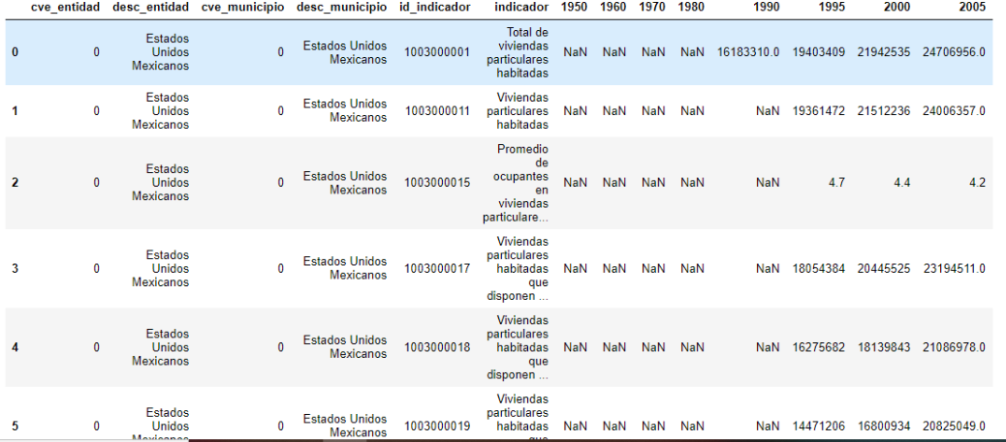
Processing
Pre Clean Data Frame

Slide 9
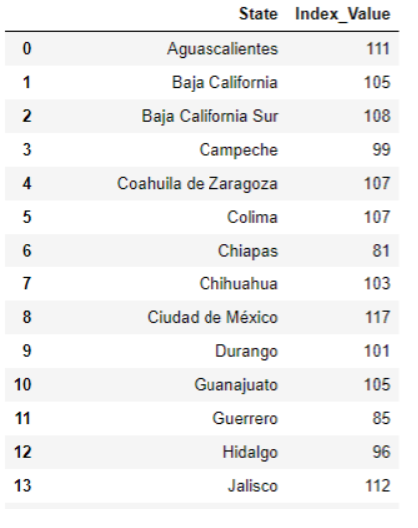
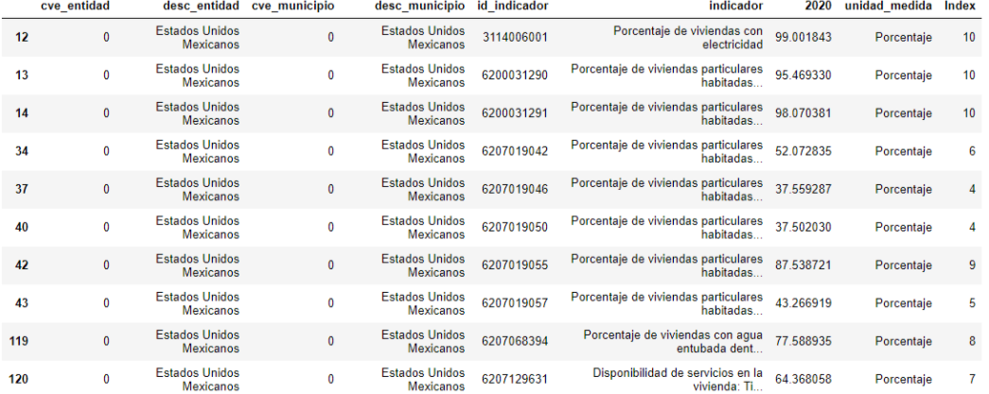
Processing
Clean Data Frame

Slide 10
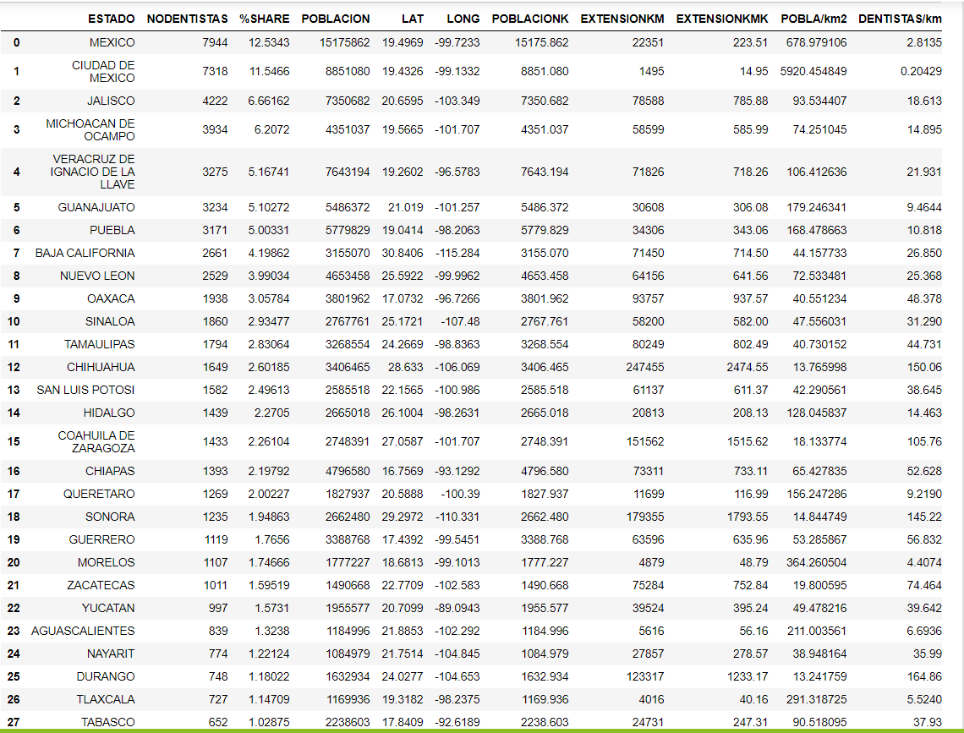
Processing
Data Frames Merged

Slide 11
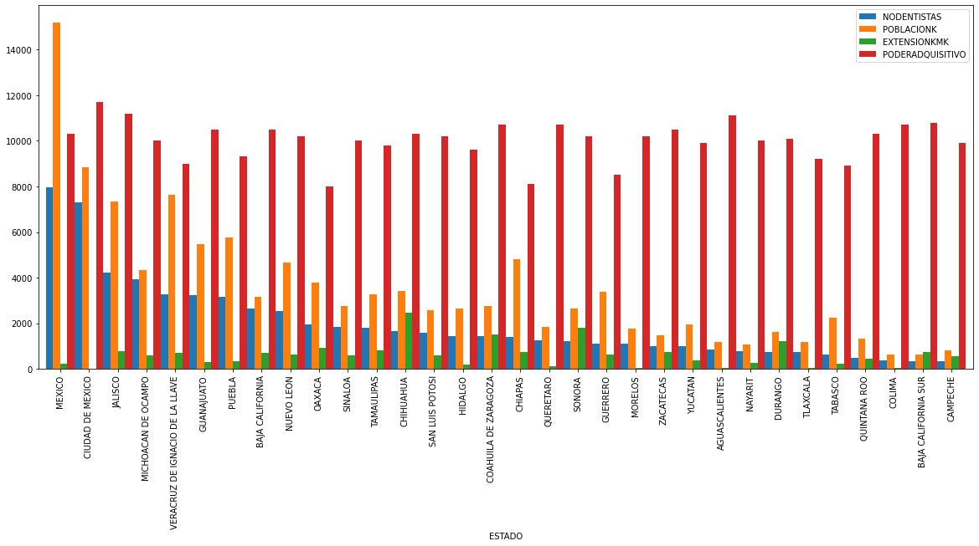
Results

Slide 12
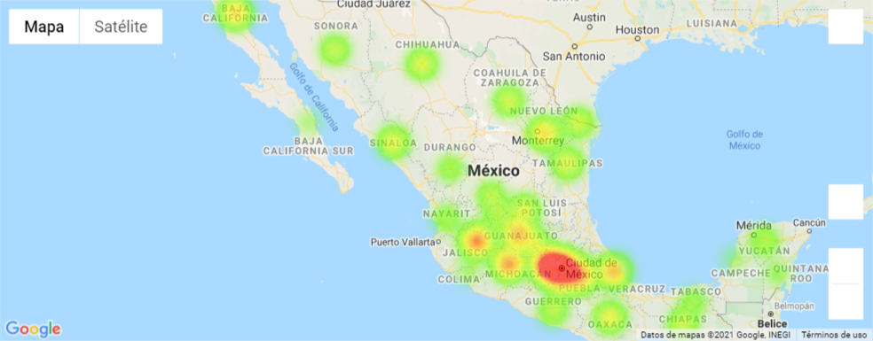
Results
Dental offices heat map

Slide 13
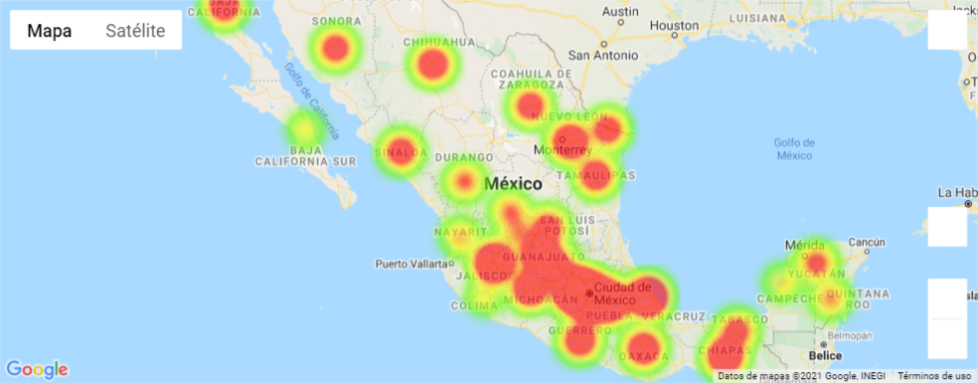
Results
Dental offices heat map
Population heat map

Slide 14
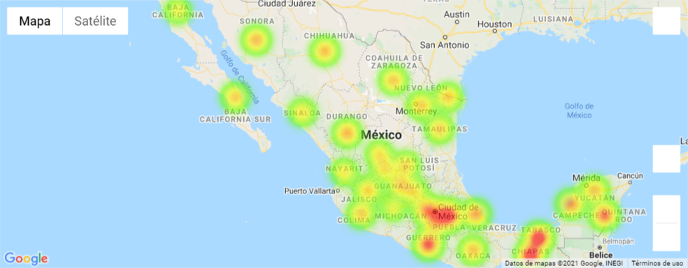
Results
Dental offices heat map
Population heat map
Map dentist by Km2

Slide 15
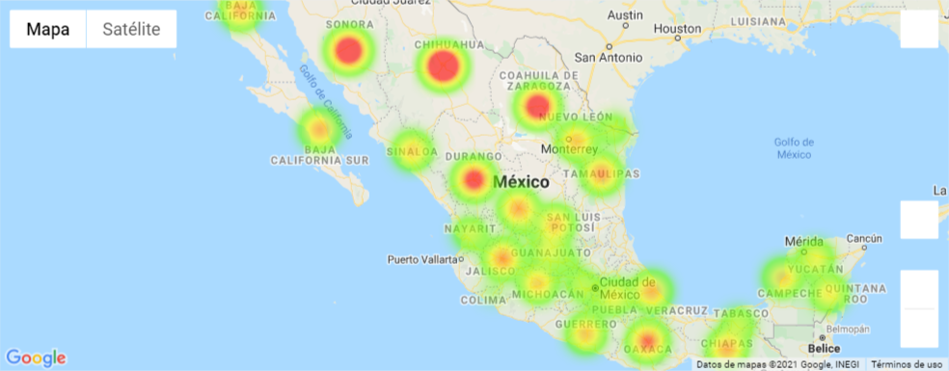
Results
Dental offices heat map
Population heat map
Map dentist by Km2
State map by Km2

Slide 16
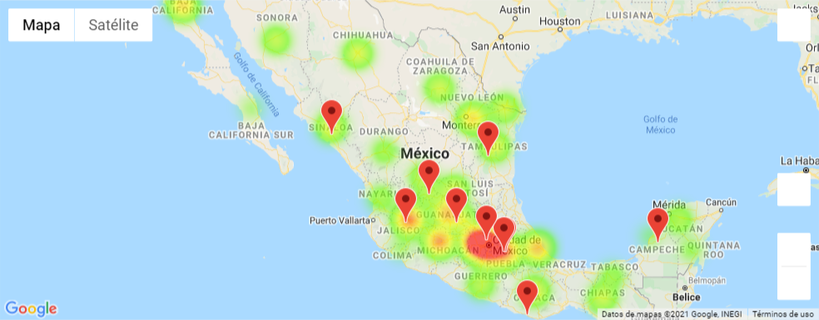
Results
Location map of dental offices
Map dentist by Km2
State map by Km2
The graph shows that there are areas in the north of the country where there are significant number of clinics and that are far from where the sales representatives are located. For example Tijuana, Hermosillo, Chihuahua and Coahuila.

Slide 17
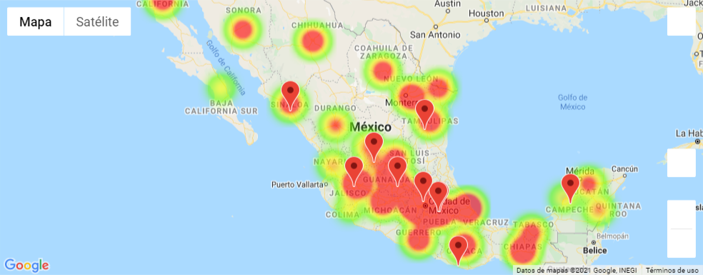
Results
Location of sales representatives on a population map
Location map of dental offices
Map dentist by Km2
State map by Km2
The graph shows that there are areas in the north and southeast of the country where there is a significant number of population and that are far from where the sales representatives are located. For example Tijuana, Hermosillo, Chihuahua, Coahuila and Chiapas.

Slide 18
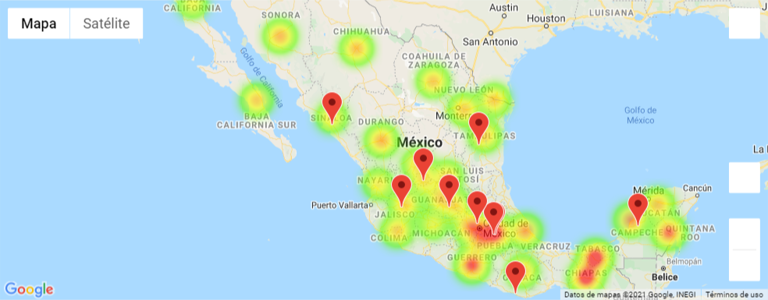
Results
Location of sales representatives on a population map
Location of sales representatives on a population by dentists
Location map of dental offices
Map dentist by Km2
State map by Km2

Slide 19
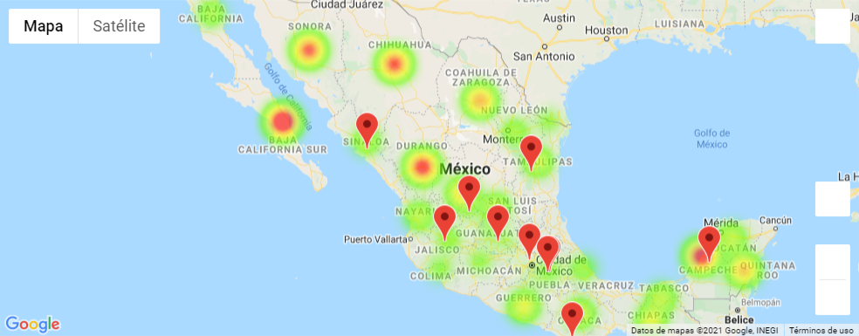
Results
Location of sales representatives on a population map
Location of sales representatives on a population by dentists
Location map of dental offices
Location of sales representatives on dentist map per Km2
Map dentist by Km2
State map by Km2

Slide 20
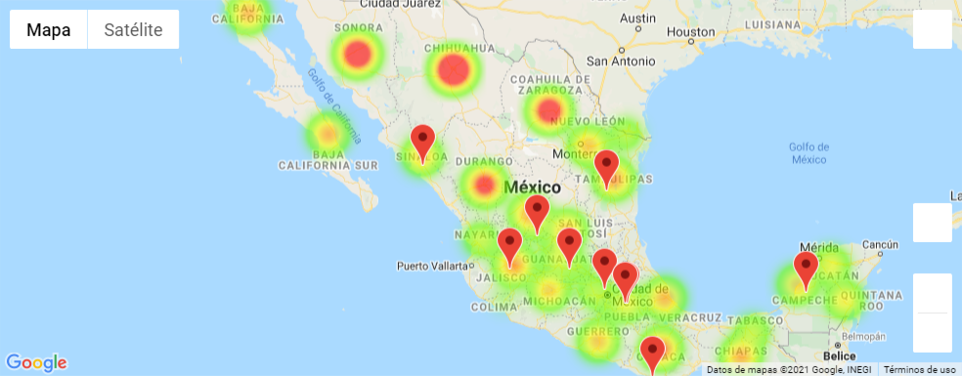
Results
Location of sales representatives on a population map
Location of sales representatives on a population by dentists
Location map of dental offices
Location of sales representatives on dentist map per Km2
Location of sales representatives on Km2 map by state
Map dentist by Km2
State map by Km2

Slide 21
Conclusions

Slide 22
Learned Lessons
Data can be located and obtained in different ways, the easiest and simplest way is always recommended.
It is important to select data from reliable sources, that way the conclusions will also be solid.
Regardless of the data sources, it is highly recommended to review and clean them before starting with the processing and analysis.
Teamwork is essential to achieve the objectives, a better result is achieved and at a better place.

Slide 23
Challenges
The conclusions reached have more to do with a qualitative analysis, based on a review of geographical graphics, however, it would be interesting to accompany it with quantitative optimization models.

